Slide 1


DroidInspect: AutoUI Inspector.
Presented by :
Md Nasir Uddin(1310)
Soumitra Paul(1317)
Supervised by:
Dr. Mohammad Shoyaib

Slide 2
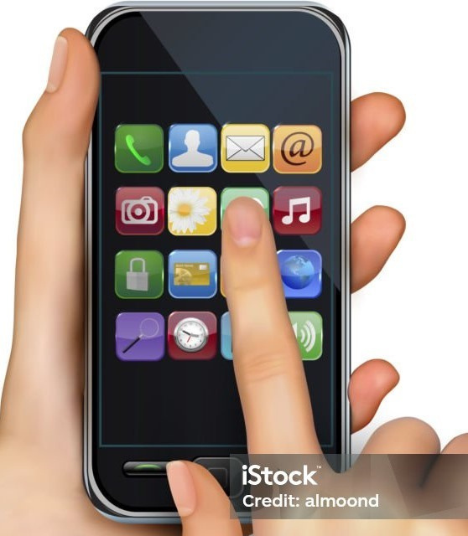


WHAT DROIDISAPECT IS?
It is lightweight UI-guided test input generator, which is able to interact with an Android app on almost any device without instrumentation.The key technique behind DroidInspect is that it can generate UI-guided test inputs based on a state transition model.

Slide 3


Stakeholders
Stakeholders
Software Company
User

Slide 4
Quality Function Deployment
(QFD)

Slide 5
Normal Requirment
A Software
Will take app’s apk file and necessary credentials as input
Getting UI information through the droidInspect tool.
Performing UI interaction through droidInspect.
Will write the generated test cases in a human readable way.
Will generate input.

Slide 6
Expected Requirements:
Having the option to give the android application APK as input
Will not make any external API calls to operate.
Will have a user interface to be interactable.
Store information in Database

Slide 7
Exciting Requirements:
Handling infinite cycles

Slide 8
Use Case Diagram

Slide 9
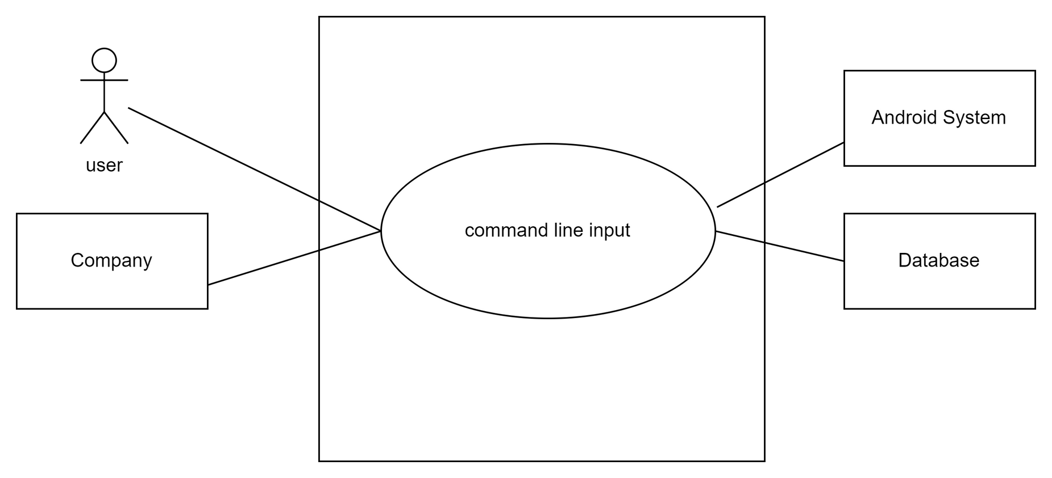

Name : DroidInspect: AutoUI Inspector
Level 0:

Slide 10
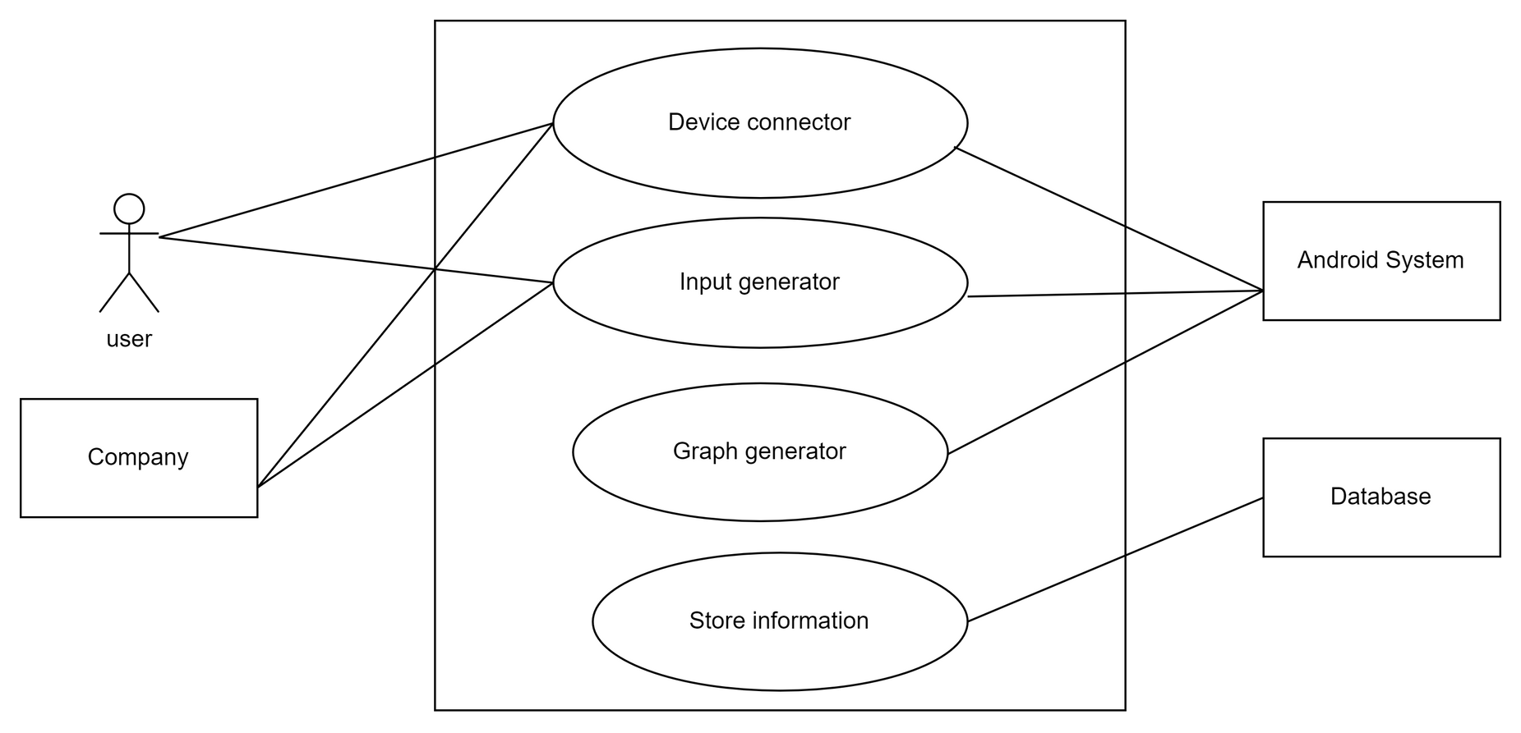
Name: Modules of DroidInspect.
Level 1:

Slide 11
Activity
Diagram

Slide 12
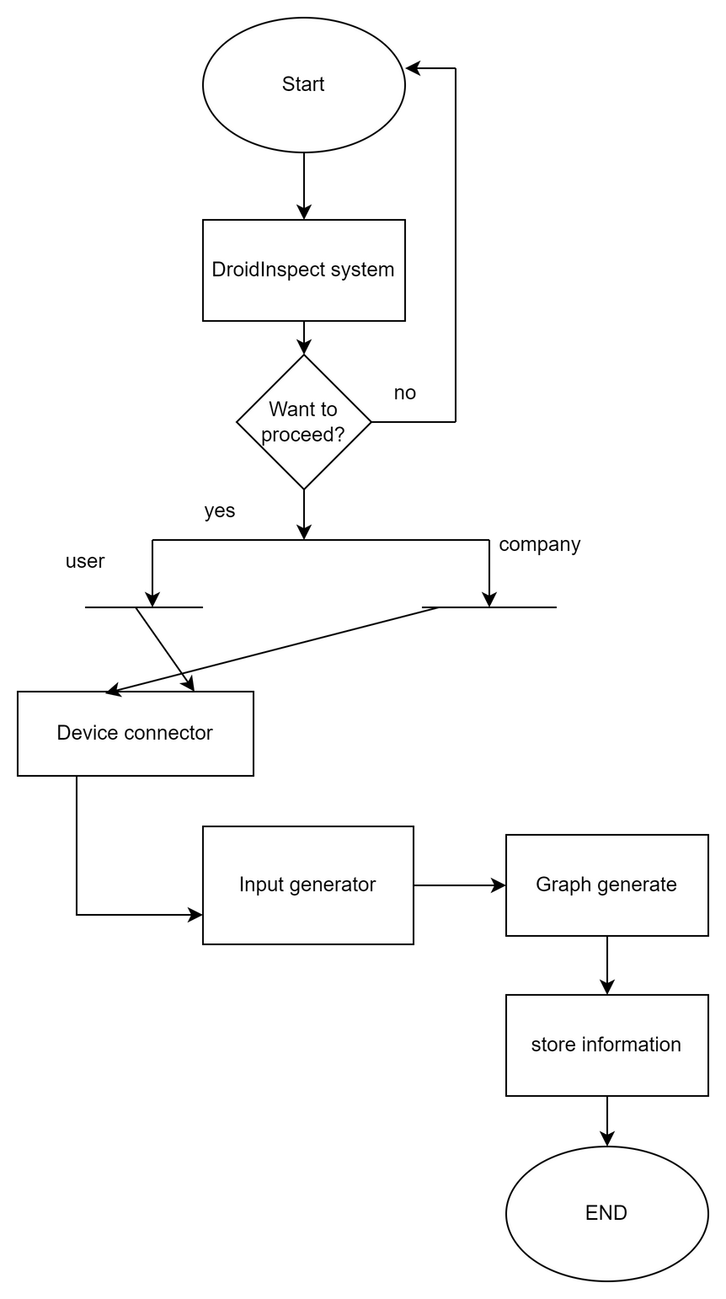
LEVEL 1:
Name: Modules of DroidInspect.
Reference: Use case Diagram Level -1

Slide 13
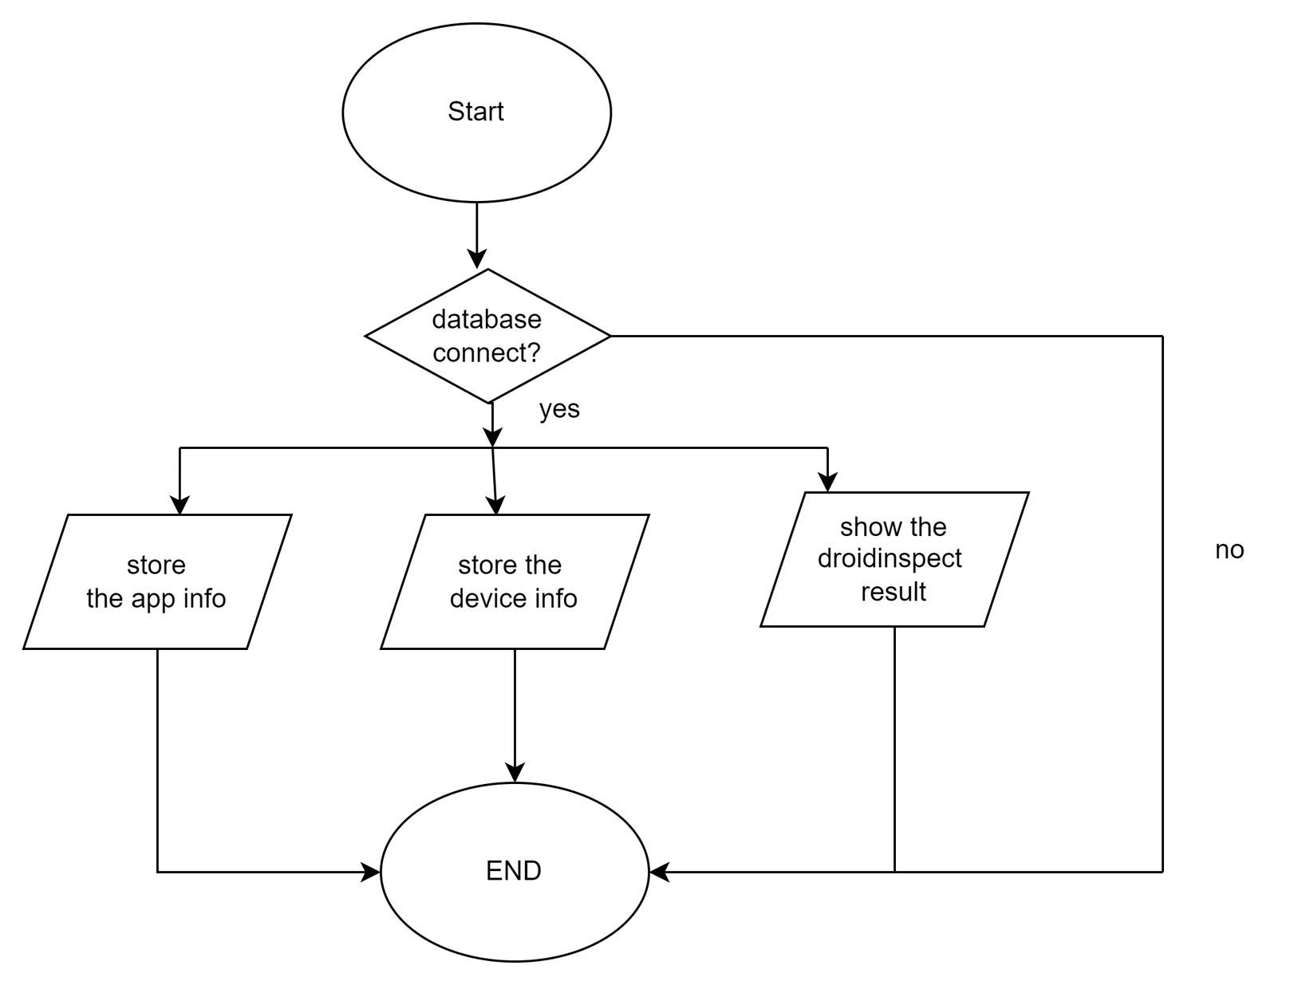
LEVEL 1.4:
Name:Store Information
Reference: Use case Diagram Level -1.4

Slide 14
Swimlane
Diagram

Slide 15
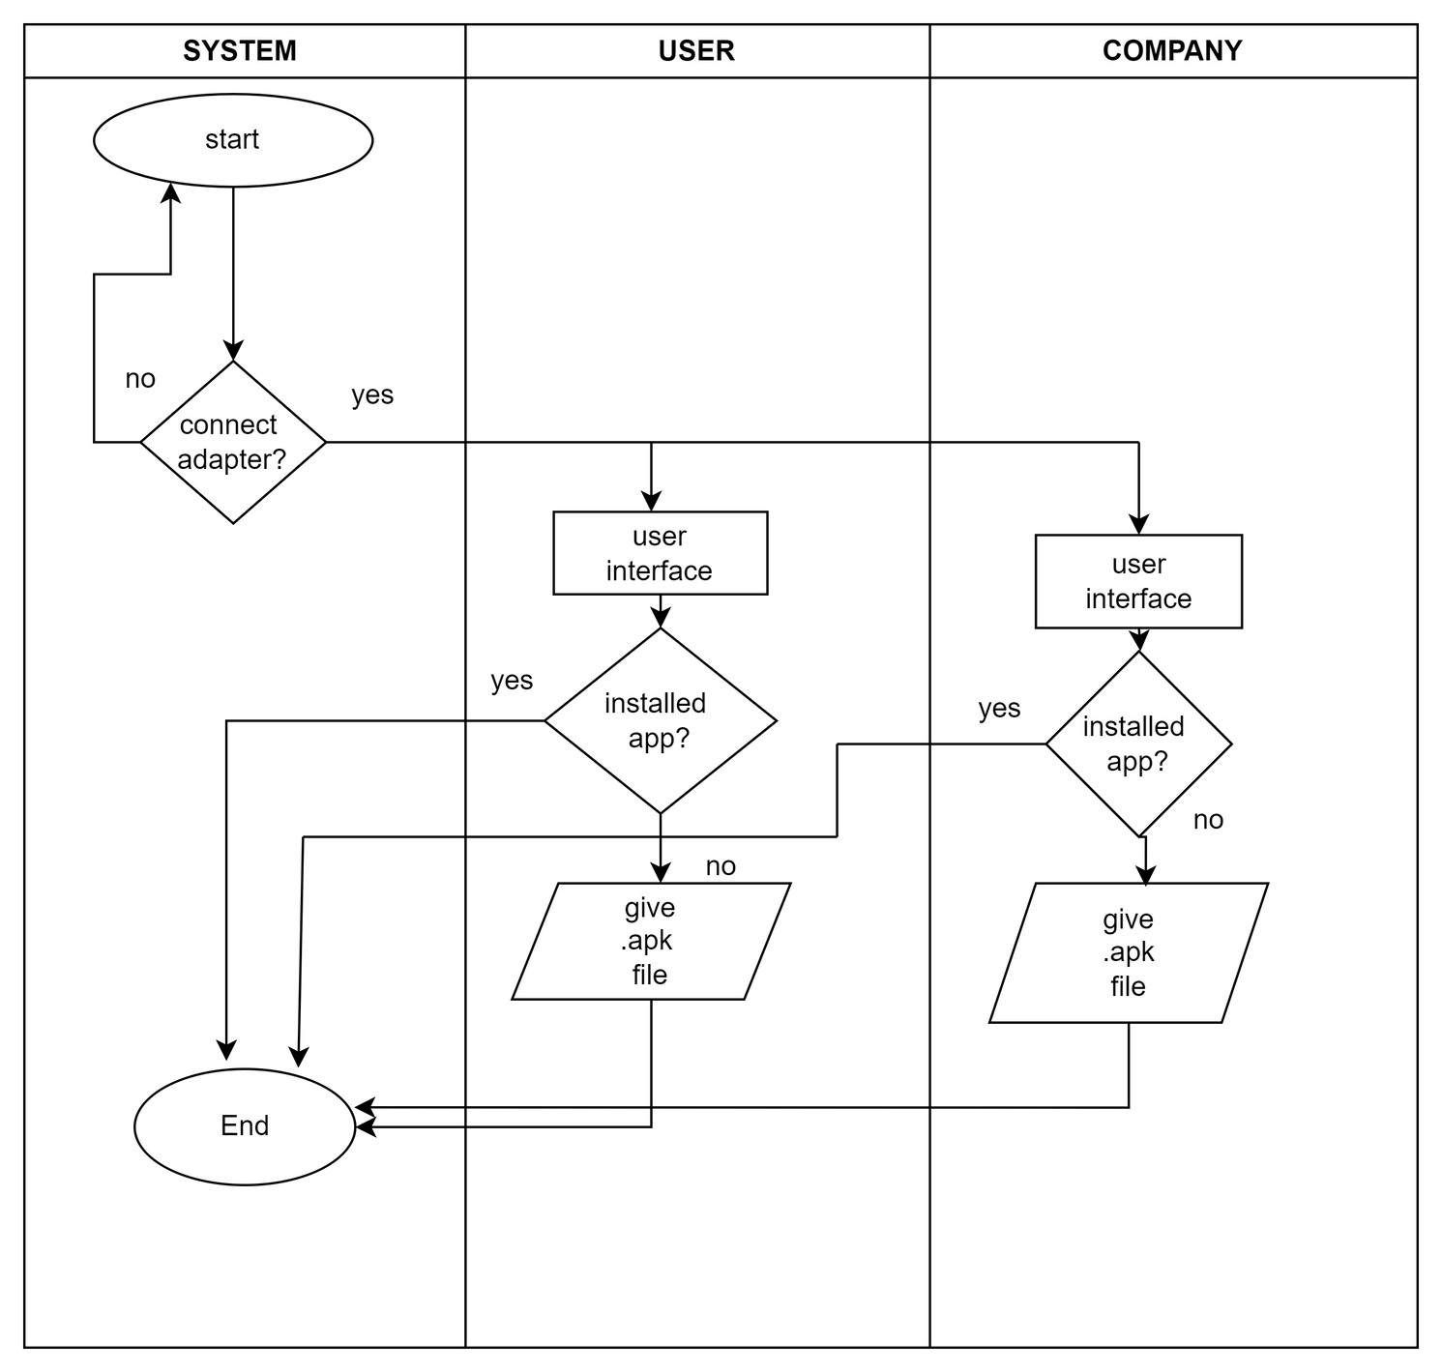
Level: 1.1
Name: Device Connector
Reference: Use Case Diagram & Activity Diagram Level – 1.1

Slide 16
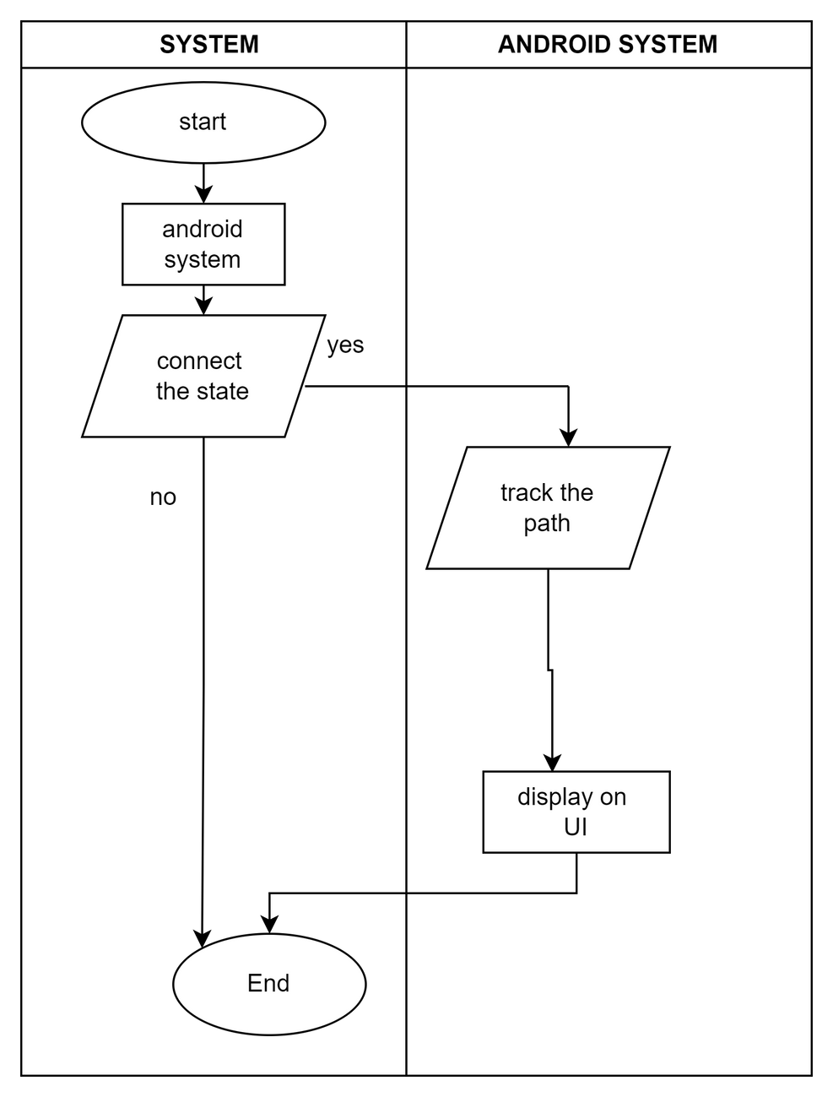
Level: 1.3
Name: Graph Generator
Reference: Use Case Diagram & Activity Diagram Level – 1.3

Slide 17
CRC

Slide 18
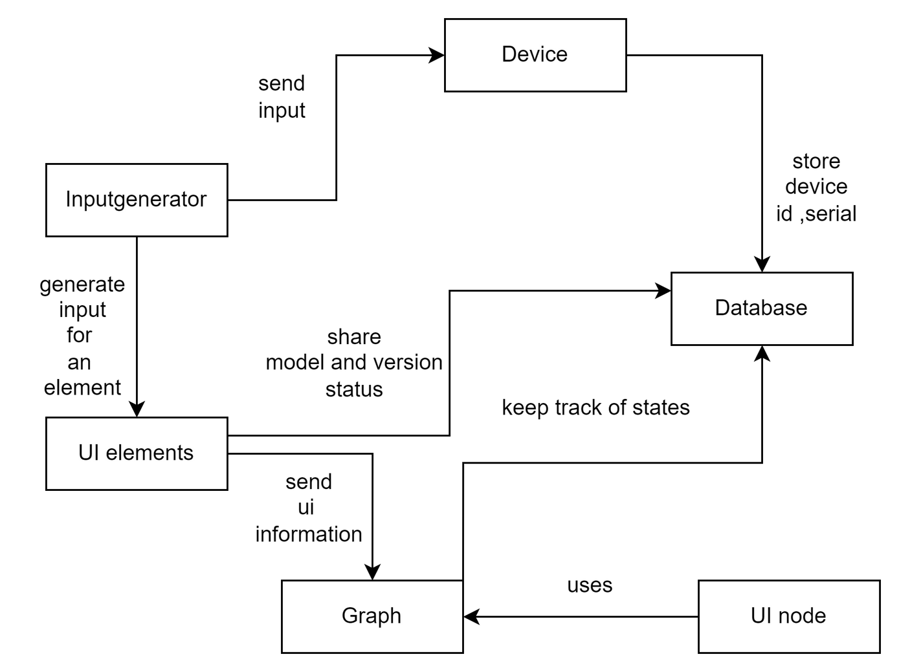
Class Responsibility and Collaboration Diagram for DroidInspect: Auto UI inspector

Slide 19
State Transition Diagram

Slide 20
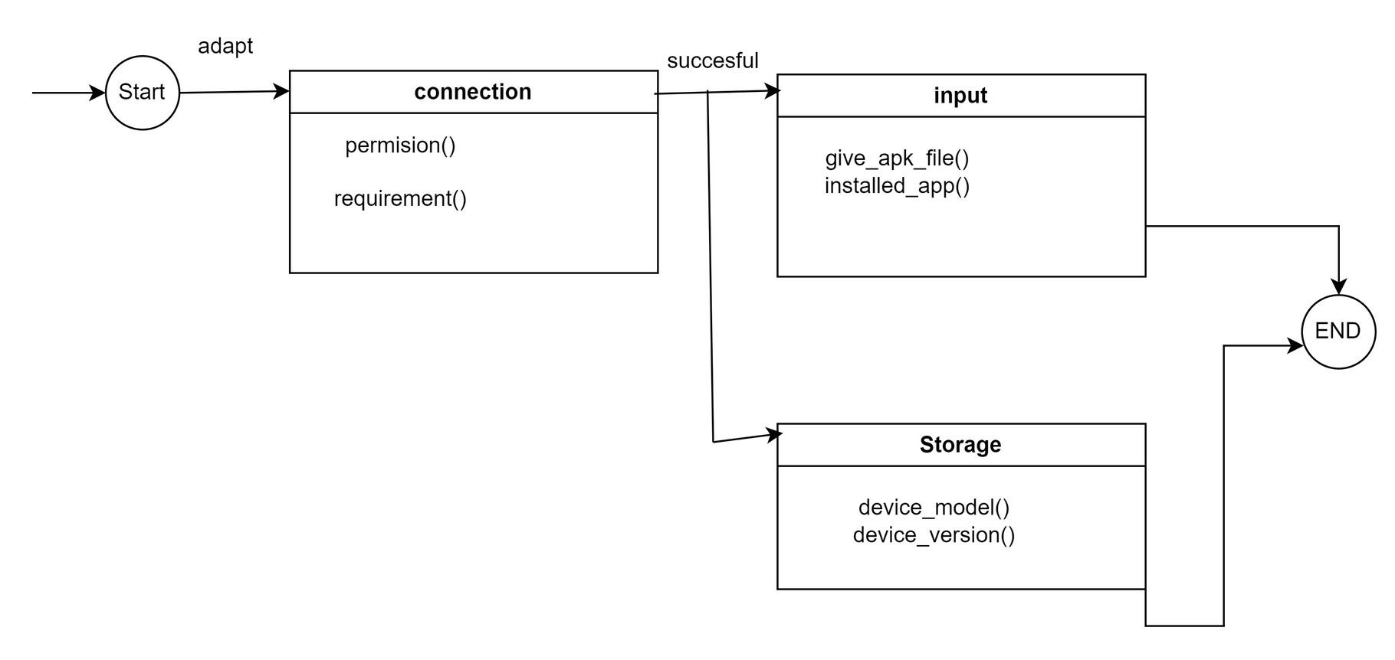
ID -1
Name : Device

Slide 21
Sequence Diagram

Slide 22
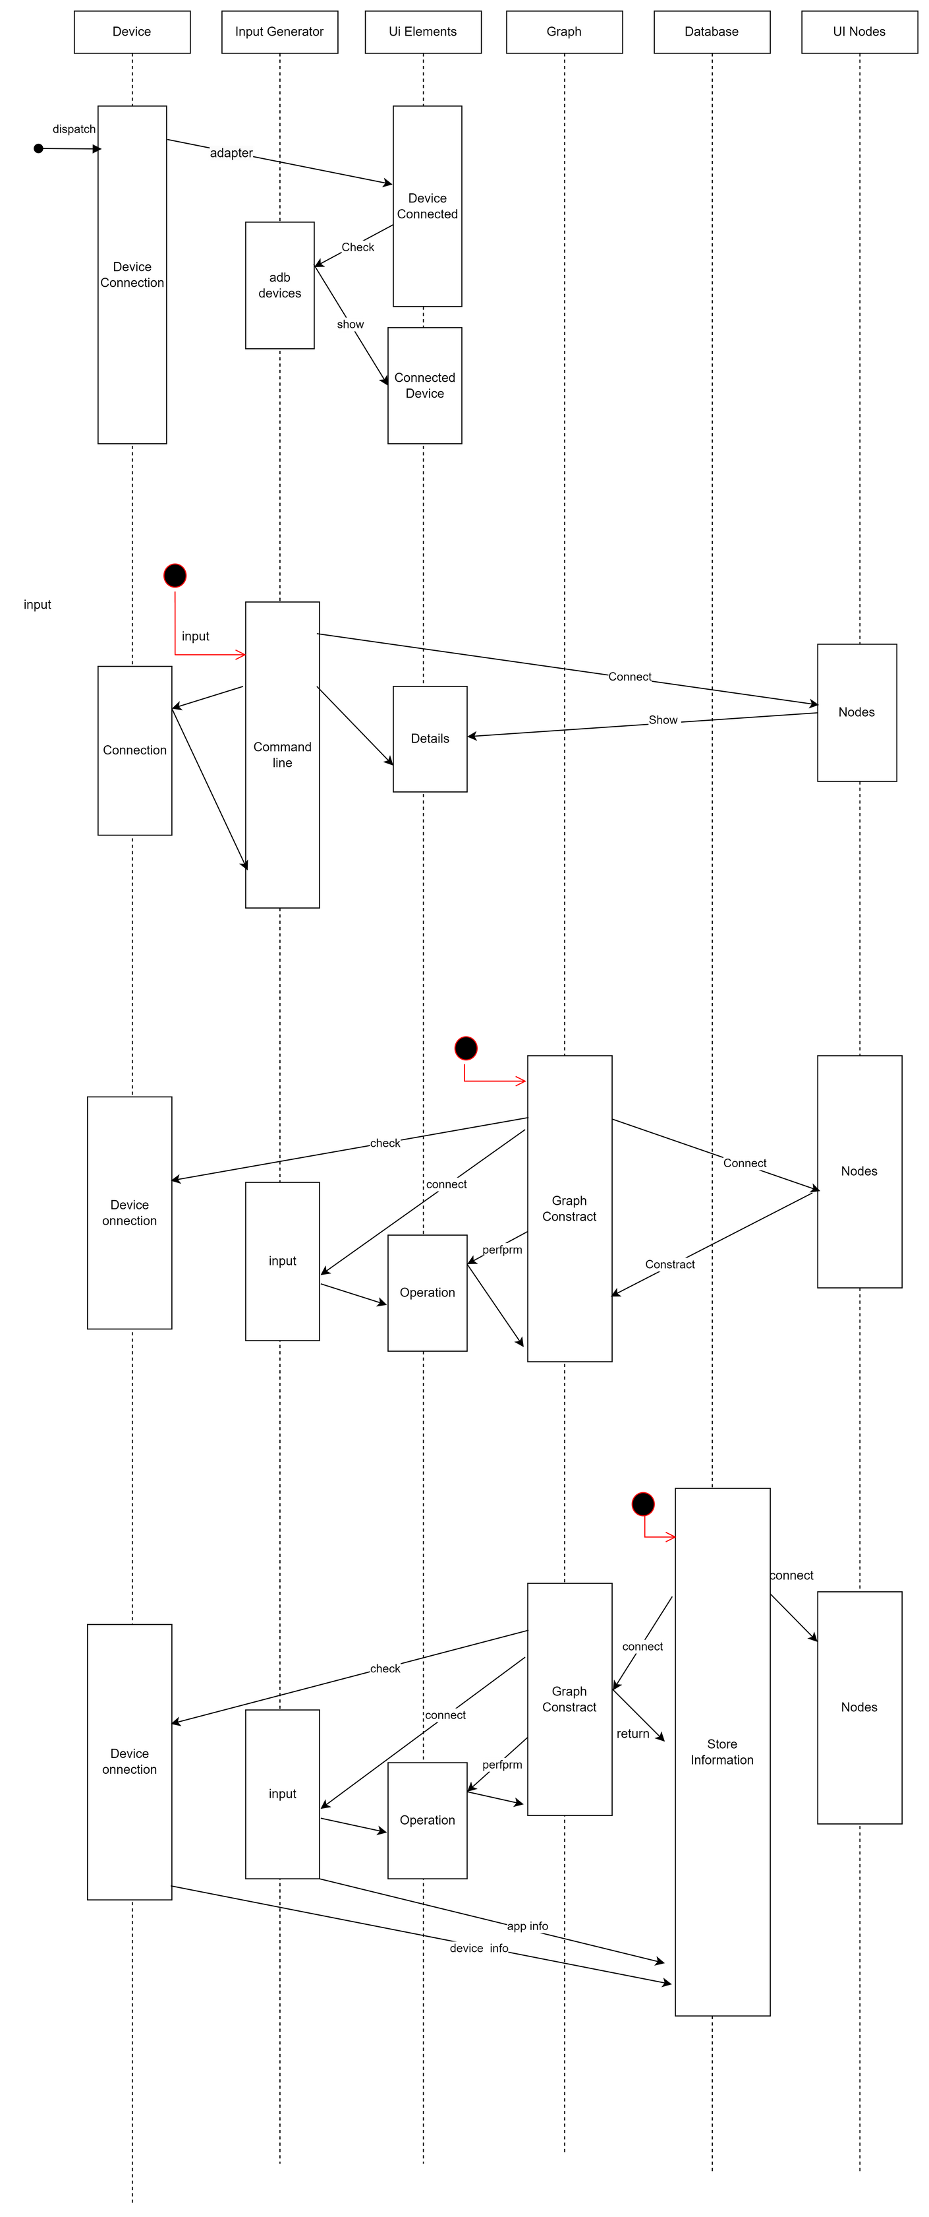
Sequence Diagram for Store Information

Slide 23

Sequence Diagram for Input Generation

Slide 24
Data Flow Diagram
(DFD)

Slide 25
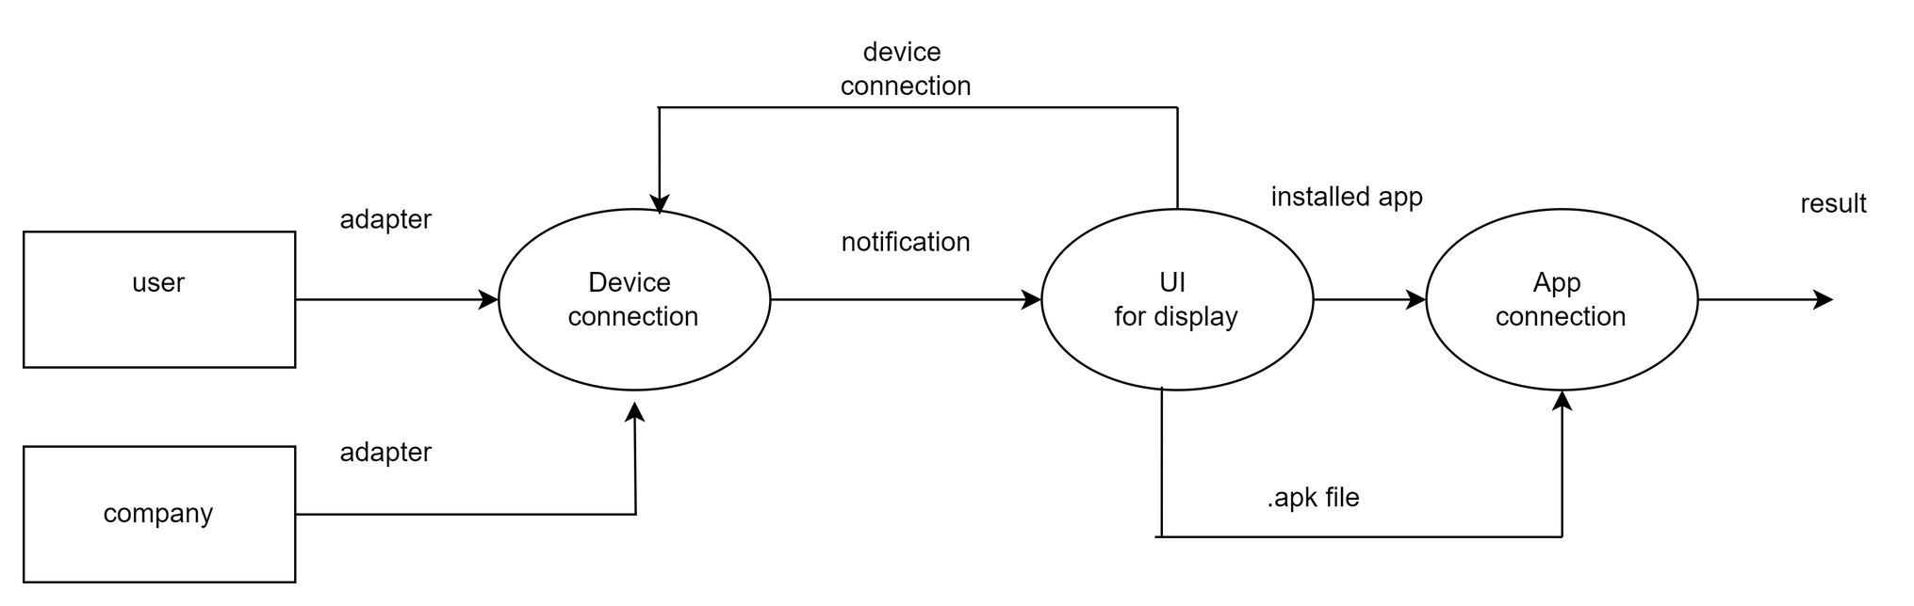
Data Flow for Device Connection

Slide 26
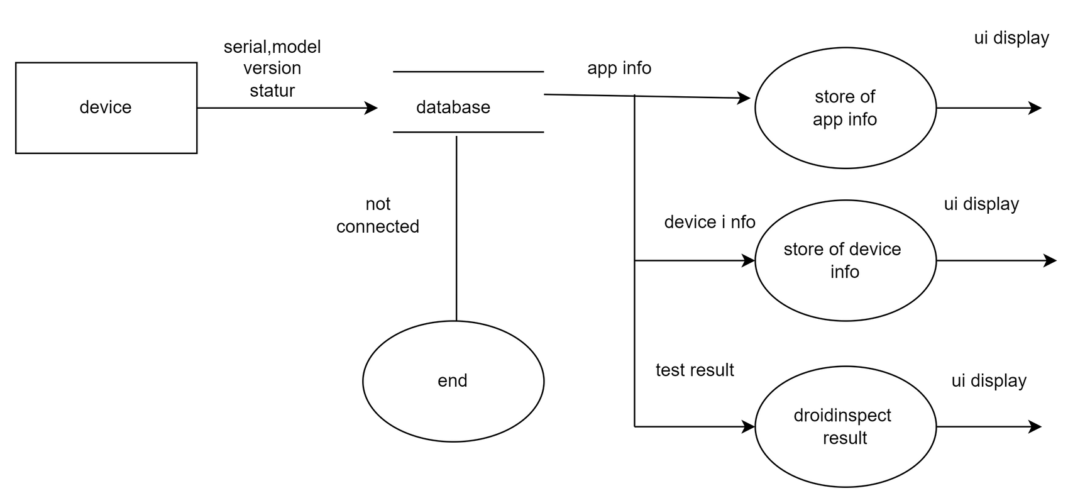
Data Flow for Store Information

Slide 27
Thank You

